Slide 1
Spring JDBC/Transaction Management
September 16, 2016

Slide 2
Spring JDBC Template
Configure data Source
Executing SQL
Transaction (Local vs Global)
Isolation
Programmatic vs. Declarative
Spring With ORM

Slide 3
Objectives
Develop an understanding of Spring JDBC module to an intermediate level covering transaction management & integration with ORM frameworks.

Slide 4
Spring JDBC Template
Spring JdbcTemplate is a powerful mechanism to connect to the database and execute SQL queries. It internally uses JDBC api, but eliminates a lot of problems of JDBC API.
The problems of JDBC API are as follows:
We need to write a lot of code before and after executing the query, such as creating connection, statement, closing resultset, connection etc.
We need to perform exception handling code on the database logic.
We need to handle transaction.
Repetition of all these codes from one to another database logic is a time consuming task.
Spring JdbcTemplate eliminates all the above mentioned problems of JDBC API. It provides you methods to write the queries directly, so it saves a lot of work and time.
Spring framework provides following approaches for JDBC database access:
JdbcTemplate
NamedParameterJdbcTemplate
SimpleJdbcTemplate
SimpleJdbcInsert and SimpleJdbcCall

Slide 5
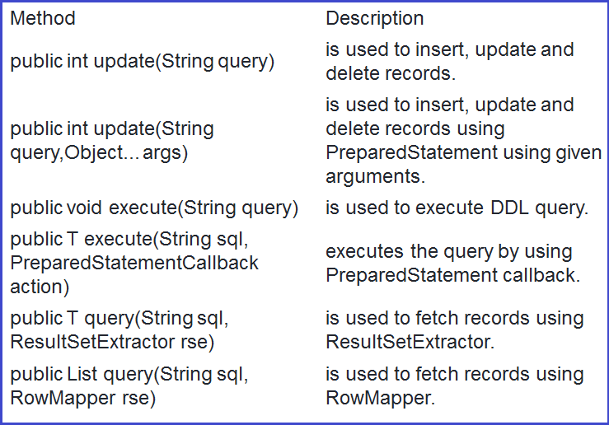
Spring JDBC Template contd…
It is the central class in the Spring JDBC support classes. It takes care of creation and release of resources such as creating and closing of connection object etc.
It handles the exception and provides the informative exception messages by the help of excepion classes defined in the org.springframework.dao package.
Let's see the methods of spring JdbcTemplate class.

Slide 6
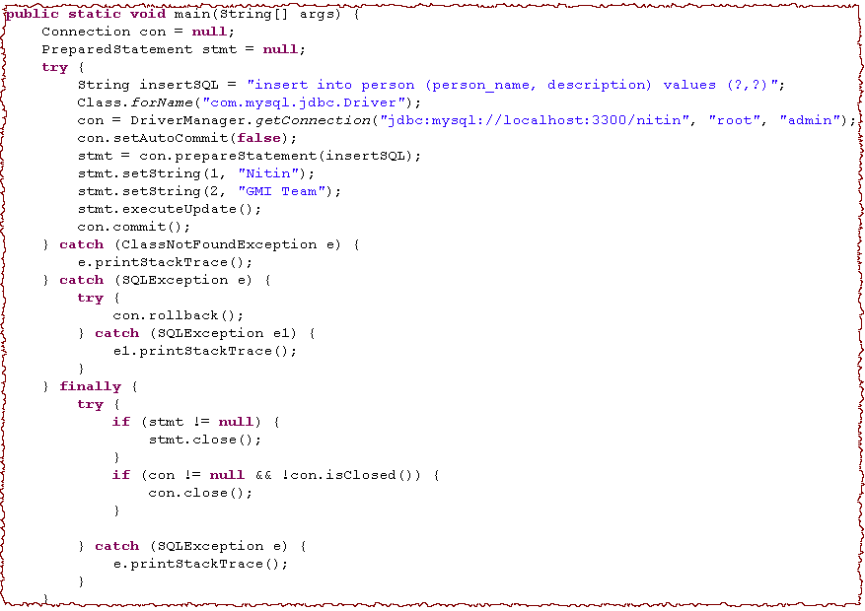
JDBC Code without Spring
Load Driver
Get Connection
Prepared Statement
Execute Update
Commit the Connection
Too much boiler plate code
Rollback the Connection
Close Statement
Close Connection

Slide 7
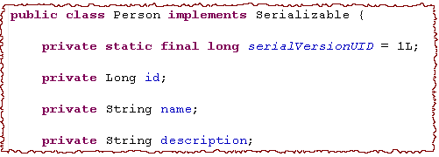
Spring JDBC Template contd…
We have a person POJO.
We want to store the data of person in the database by using Spring-JDBC Integration support.

Slide 8
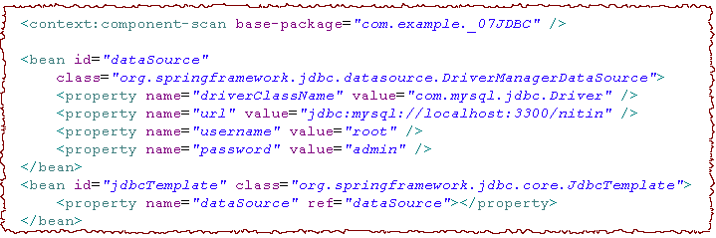
Step 1: Configure datasource
Define Data Source
Spring defined JDBC Template
Connection Pool can also be used in place of simple DB Connection
A JDBCTemplate bean is defined in the configuration file. A template class takes care of boilerplate code. Almost immediately, we will look at the DAO class having no boilerplate code.

Slide 9
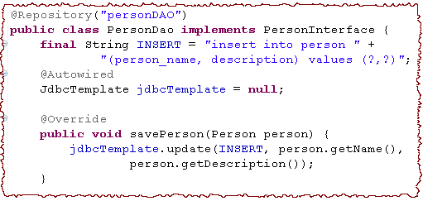
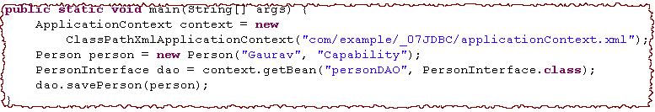
Step 2: DAO Class Implementation(Executing SQL)
Stereotype Annotation
Template Dependency
No Boilerplate code
Step 3: Client Code

Slide 10
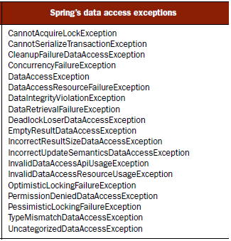
Exception Handling
Spring framework define its own set of run time exceptions for the database communication. Database exception APIs of Spring are independent of the underlying database connectivity framework.
This is the responsibility of template class to wrap the underlying database connectivity framework exception in the Spring API exception.
All data access exceptions are runtime exception.

Slide 11
Exercise
Create an employee management system which has Employee object.
Create service and DAO layers and use Spring JDBC to connect to DB in the DAO layer.
Implement all CRUD operations of JDBCTemplate and have corresponding method implementations in service layer

Slide 12
ACID Properties of a transaction
Atomicity
Either all or none of the transaction's operations are performed.
Atomicity requires that if a transaction is interrupted by a failure, its partial results must be undone.
The activity of preserving the transaction's atomicity in presence of transaction aborts due to input errors, system overloads, or deadlocks is called transaction recovery.
Consistency
A transaction which executes alone against a consistent database leaves it in a consistent state.
Transactions do not violate database integrity constraints.
Durability
Once a transaction commits, the system must guarantee that the results of its operations will never be lost, in spite of subsequent failures.
In other words, every committed transaction is protected against power loss/crash/errors and cannot be lost by the system and can thus be guaranteed to be completed.

Slide 13
Isolation
If several transactions are executed concurrently, the results must be the same as if they were executed serially in some order.
Consider the following two transactions:
T1: Read(x) T2: Read(x)
x ←x+1 x ←x+1
Write(x) Write(x)
Commit Commit
Possible execution sequences:
T1: Read(x) T1: Read(x)
T1: x ←x+1 T1: x ←x+1
T1: Write(x) T2: Read(x)
T1: Commit T1: Write(x)
T2: Read(x) T2: x ←x+1
T2: x ←x+1 T2: Write(x)
T2: Write(x) T1: Commit
T2: Commit T2: Commit

Slide 14
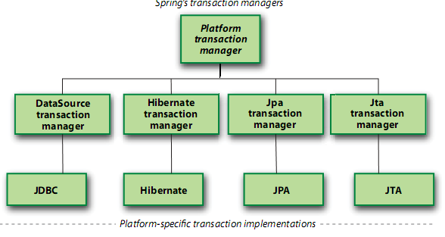
Transaction managers in spring framework
Spring does not directly manage the transactions, instead it comes with the selection of transaction managers that delegates the responsibility for transaction management to a platform specific transaction implementation provided by either JTA or the persistence mechanism.

Slide 15
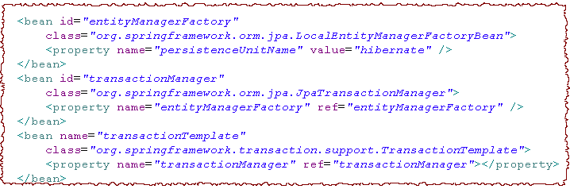
Programmatic Transaction
Programmed needs to define transaction boundaries in Java code.
Programmer needs to rollback the transaction in case of failure.
Below steps need to be taken to start a programmatic transaction:
Step 1: The Configuration XML
JPA Transaction Manager
Transaction Template

Slide 16
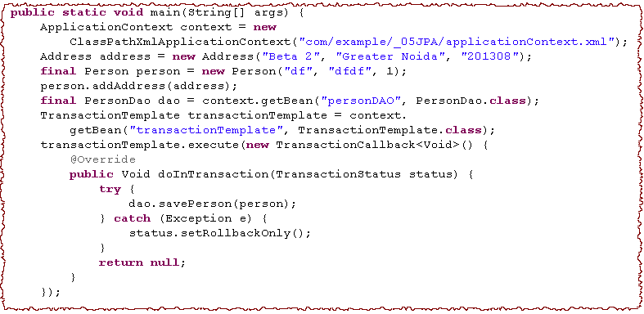
Step 2: The Client Code
Start Transaction
Transaction Operation
Rollback for Exception

Slide 17
Exercise : Coding – Spring Programmatic Transaction
Create an Equity class with attributes
symbol : String
securityName : String
type : String (Buy / Sell)
qty : int
Create getters and setters for them.
Save the Equity object to the database by Spring-JPA Integration by using programmatic transaction.

Slide 18
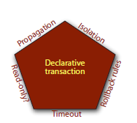
Declarative Transaction
Transaction management is a cross cutting concern for the application developer. As a replacement for programmatic transaction, Spring define a mechanism to declare transactions in configuration file.
Declarative transaction of spring framework is a result of aspect oriented programming. Spring supports run time waiving of aspect at method join-points. As a result, boundaries of a declarative transaction are defined on method level.
Declarative transaction is defined in terms of certain transaction attributes. These transaction attributes are declared on a transactional method that is overridden in the AOP proxy by incorporating the behavior of transaction parameter.
Transaction Attributes
Propagation Behavior
Isolation Level
Rollback Rules
Timeout
Read-only

Slide 19
Propagation Behavior
We have already quantified that transaction boundaries are declared on the methods.
Let us suppose that a method m1() is executing within a transaction boundaries t1. Another method m2() is called from m1(). Transaction boundaries of method m2() can be declared relative to its calling method m1().
For example, either m2() can be executed in the same transaction t1 or m2() can have its own transaction boundaries t2.
Propagation rules answer the question of whether a new transaction should be started or suspended, or if a method should even be executed within a transactional context at all.

Slide 20
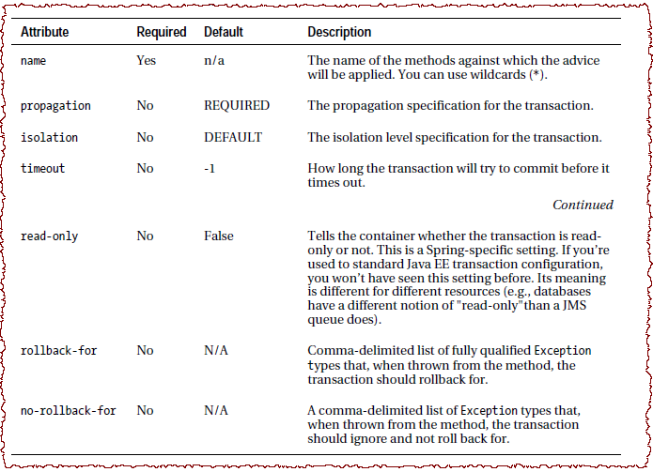
Transaction Attributes

Slide 21
Spring Propagation Declaration
Propagation behavior | What it means
PROPAGATION_MANDATORY | Indicates that the method must run within a transaction. If no existing transaction is in progress, an exception will be thrown.
PROPAGATION_NESTED | Indicates that the method should be run within a nested transaction if an existing transaction is in progress. The nested transaction can be committed and rolled back individually from the enclosing transaction. If no enclosing transaction exists, behaves like PROPAGATION_REQUIRED. Vendor support for this propagation behavior is spotty at best. Consult the documentation for your resource manager to determine if nested transactions are supported.
PROPAGATION_NEVER | Indicates that the current method shouldn’t run within a transactional context. If an existing transaction is in progress, an exception will be thrown.
PROPAGATION_NOT_SUPPORTED | Indicates that the method shouldn’t run within a transaction. If an existing transaction is in progress, it’ll be suspended for the duration of the method. If using JTATransactionManager, access to TransactionManager is required.
PROPAGATION_REQUIRED | Indicates that the current method must run within a transaction. If an existing transaction is in progress, the method will run within that transaction. Otherwise, a new transaction will be started.
PROPAGATION_REQUIRES_NEW | Indicates that the current method must run within its own transaction. A new transaction is started and if an existing transaction is in progress, it’ll be suspended for the duration of the method. If using JTATransactionManager, access to TransactionManager is required.
PROPAGATION_SUPPORTS | Indicates that the current method doesn’t require a transactional context, but may run within a transaction if one is already in progress.

Slide 22
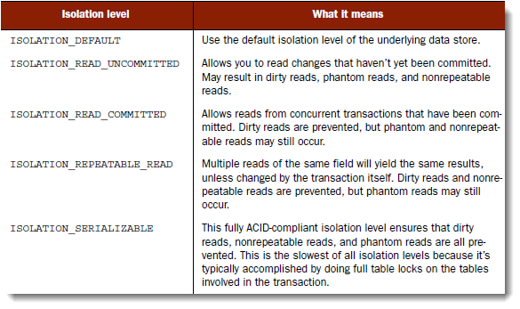
Isolation Level
Isolation levels determine to what degree a transaction may be impacted by other transactions being performed in parallel.

Slide 23
Read-Only
If a transaction performs only read operations against the underlying data store, the data store may be able to apply certain optimizations that take advantage of the read-only nature of the transaction. By declaring a transaction as read-only, you give the underlying data store the opportunity to apply those optimizations as it sees fit.
Transaction Timeout
Suppose that your transaction becomes unexpectedly long-running. Because trans- actions may involve locks on the underlying data store, long-running transactions can tie up database resources unnecessarily. Instead of waiting it out, you can declare a transaction to automatically roll back after a certain number of seconds.
Rollback Rules
We declare a set of rules that define which exceptions prompt a rollback and which ones don’t. By default, transactions are rolled back only on runtime exceptions and not on checked exceptions..

Slide 24
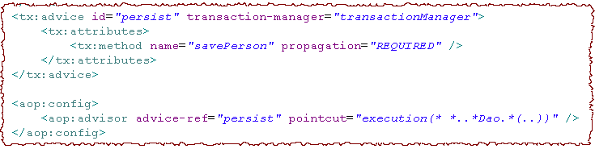
Declarative Transaction in XML
Below lines need to be added in the configuration XML.
Transaction Attributes
Method Name
Declarative Transaction with Annotation
Look at the Spring – JPA integration Example.

Slide 25
Exercise : Coding – Spring Declarative Transaction
Create an Equity class with attributes
symbol : String
securityName : String
type : String (Buy / Sell)
qty : int
Create getters and setters for them.
Save the Equity object to the database by Spring-JPA Integration by using declarative transaction.
Cover all the propogation & isolation attributes.

Slide 26
XA Transactions
In the early days of computing, there was no need for distributed transactions. As number of applications increased, synchronization of the data become an important issue.
As a result, the 2 phase commit protocol referred to as XA(eXtended Architecture) arose. This protocol provides ACID-like properties for global transaction processing.
2 phase commit protocol is an atomic commitment protocol for distributed systems. This protocol as its name implies consists of two phases.
The first one is commit-request phase in which transaction manager coordinates all of the transaction resources to commit or abort.
In the commit-phase, transaction manager decides to finalize operation by committing or aborting according to the votes of the each transaction resource.
For further reading refer to the following article :
https://dzone.com/articles/xa-transactions-2-phase-commit

Slide 27
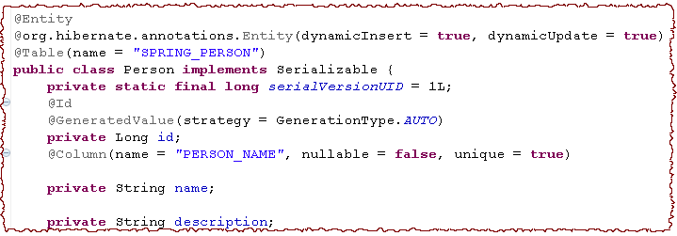
Lets Do It by Spring – JPA Integration
We have a person POJO annotated with JPA annotations.
We want to store the data of person in the database by using Spring-JPA Integration support.

Slide 28
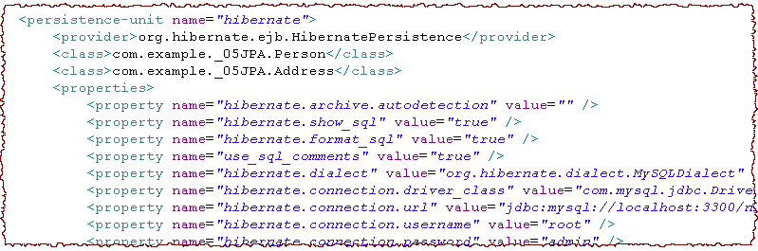
Step 1: Add META-INF/persistence.xml to classpath

Slide 29
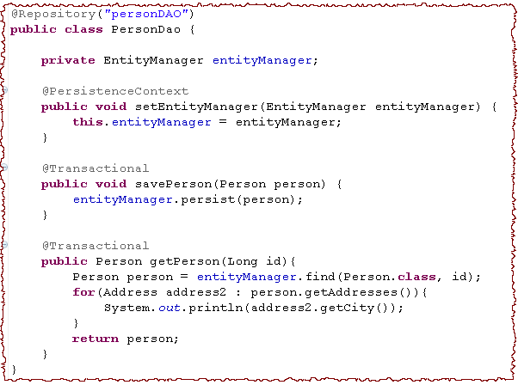
Step 2: Add a DAO class
@Repository Stereotype
EntityManager. JpaTempate is deprecated.
Spring support of JEE standard annotation for JPA
Declarative transaction
If @Transactional is not used, Lazy loading is failed

Slide 30
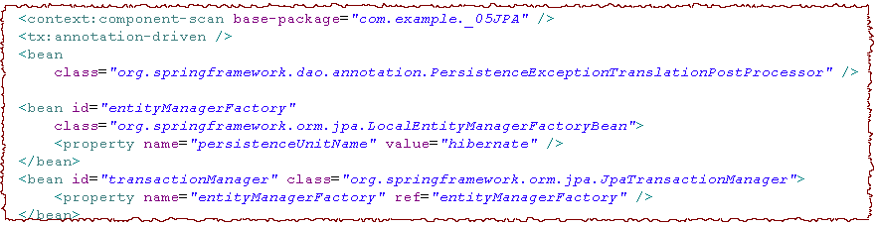
Step 3: Spring XML Configuration
Annotation Driven Transaction
Add Spring exception handling to @Repository
To enable declarative transaction management for the methods annotated with @Transactional, you have to enable the <tx:annotation-driven> element in your bean configuration file. By default, it will look for a transaction manager with the name transactionManager.
Name transationManager is required
JPA Transaction Manager

Slide 31
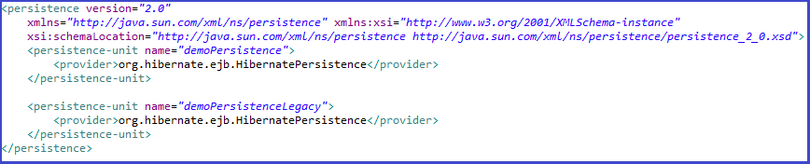
Configuring multiple datasources
Step 1 : Modify Persisitence.xml
Add a new Persistence unit- demoPersistenceLegacy in addition to the old one- demoPersistence.

Slide 32
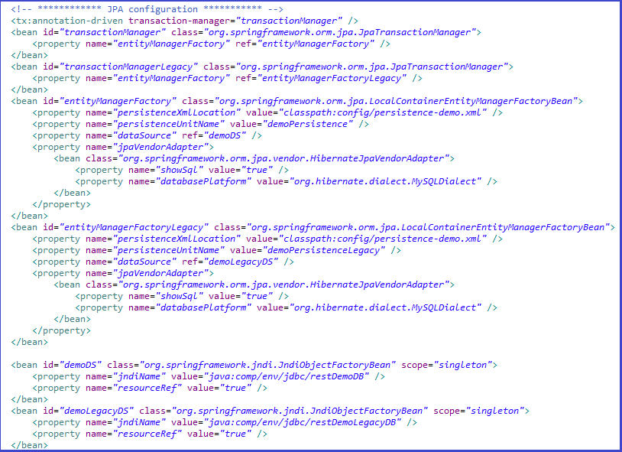
Configuring multiple datasources
Step 2 : Modify ApplicationContext.xml
Define 2 JpaTransactionManager, EntityManager & datasources in ApplicationContext.xml- Spring XML configuration file.

Slide 33
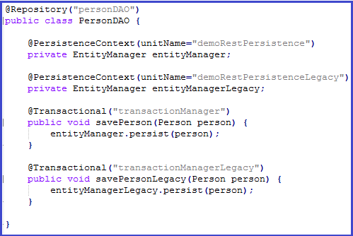
Configuring multiple datasources
Step 2 : Modify DAO class
Modify DAO class by specifying EntityManager to be used :

Slide 34
Exercise : Coding – Spring JPA Integration
Create an Equity class with attributes
symbol : String
securityName : String
type : String (Buy / Sell)
qty : int
Create getters and setters for them.
Save the Equity object to the database by Spring-JPA Integration.

Slide 35
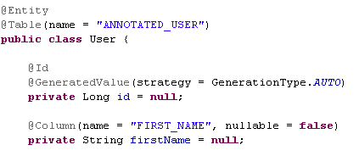

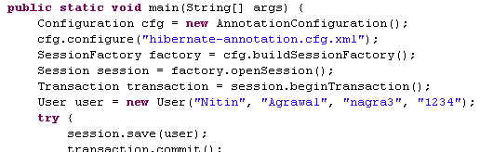
Hibernate Code without Spring
Since JAVA 5, annotation is seen as a replacement of XML configuration. Hibernate 3 also supports annotation based table mapping as follows:
Annotated Class
Annotated Class Mapping in Configuration file
Annotated Configuration

Slide 36
Lets Do It by Spring
We have a person POJO annotated with hibernate annotations.
We want to store the data of person in the database by using Spring-Hibernate Integration support.

Slide 37
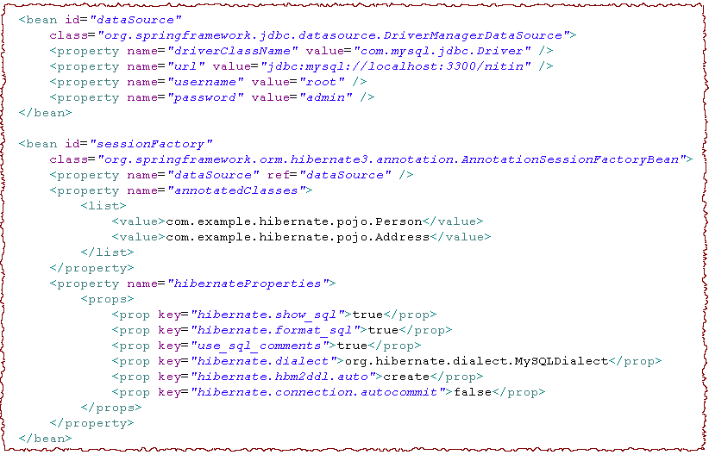
Step 1: Define Hibernate Properties in Spring configuration
Define Data Source
Connection Pool can also be used in place of simple DB Connection
Spring implementation of Session Factory
Define a bean for Hibernate Session Factory
Hibernate Configuration

Slide 38
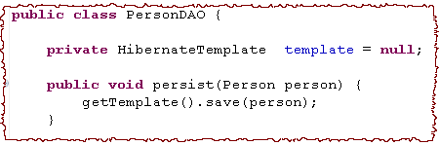
Step 2: Define Hibernate Template Bean in XML
Referring the session factory
Step 3: Create a DAO class with Template Dependency
Hibernate Template Dependency
Step 4: Define a DAO Bean

Slide 39
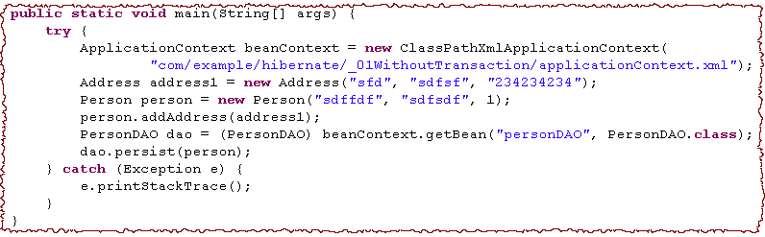
Step 5: Client Code
Get the DAO Bean
Persist the date
In contrast of plain hibernate application
No Configuration object is created in the client code
No Session Factory is created
No Session object is created
No Transaction is started
No transaction commit and rollback is done
Hibernate template takes care for the boilerplate code of Hibernate client.

Slide 40
Exercise : Coding – Spring Hibernate Integration
Create an Equity class with attributes
symbol : String
securityName : String
type : String (Buy / Sell)
qty : int
Create getters and setters for them.
Save the Equity object to the database by Spring-Hibernate Integration.

Slide 41

Hibernate DAO support
For each DAO, we have to add a dependency of Hibernate template.
Spring provide DAO support classes for every template class to overlook this practice. Below changes are required in the PersonDAO and configuration file.
Hibernate Template Dependency
Extending HibernateDaoSupport
No Template Dependency
Injecting Session Factory

Slide 42
Exercise : Coding – Spring Hibernate Integration
Create an Equity class with attributes
symbol : String
securityName : String
type : String (Buy / Sell)
qty : int
Create getters and setters for them.
Save the Equity object to the database by Spring-Hibernate DAO support class.

Slide 43
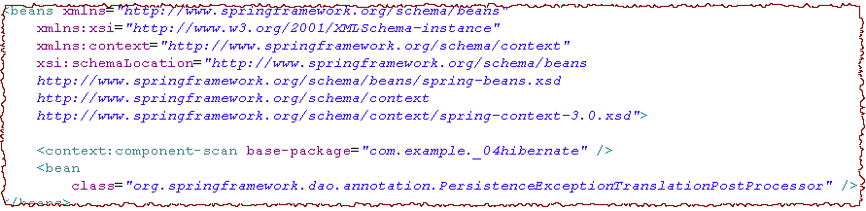
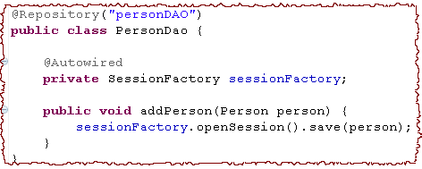
Hibernate-Spring Integration by Annotations
Configuration File
DAO Class
Add Spring exception handling to @Repository

Slide 44
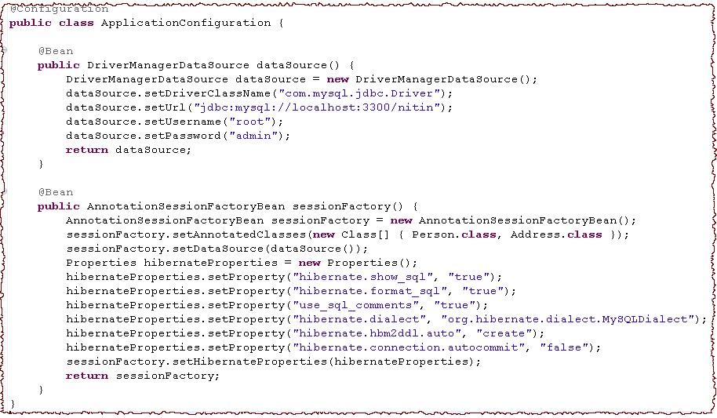
Configuration in JAVA File

Slide 45
Exercise : Coding – Spring Hibernate Integration
Create an Equity class with attributes
symbol : String
securityName : String
type : String (Buy / Sell)
qty : int
Create getters and setters for them.
Save the Equity object to the database by Spring-Hibernate Integration with annotation.

Slide 46
Recap
In Spring JDBC tutorial we have covered the following topics :
Spring JDBC Template
Configure data Source
Executing SQL
Transaction (Local vs Global)
Propogation attribute
Isolation
Programmatic vs. Declarative
Spring With JPA
Spring Hibernate Integration

Slide 47
References
docs.spring.io/spring/docs/current/spring-framework-reference/html/jdbc.html
www.tutorialspoint.com/spring/spring_jdbc_example.htm
www.javatpoint.com/spring-JdbcTemplate-tutorial
https://www.mkyong.com/spring/maven-spring-jdbc-example/

Slide 48
THANK YOU

